Slide 1

Module 5
Model Building
Notes:
Guidelines
Use section headers to chunk content in your presentation.
Use the same style of section header throughout your presentation.
Keep your title to no more than 2 lines.

Slide 2
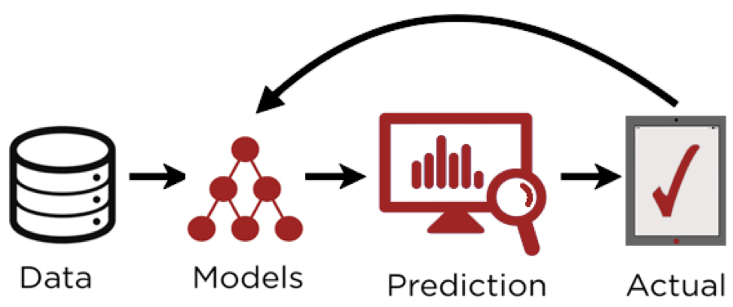
Predictive Modeling
Notes:
Guidelines
Use a title slide at the beginning of your presentation. There are 9 variations of title slides to choose from.
If you will have a series of slideshows, we recommend using the same style of title slide for each presentation.
Keep your title to no more than 2 lines.
Do not change the font style or font size of the title or subtitle.

Slide 3
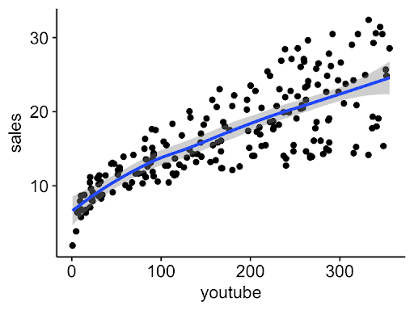
Explanatory (Descriptive) Models
Aim to understand and interpret the underlying relationships
Help explain why or how something happens.
Emphasis on model interpretability.
Performance is measured by goodness of fit metrics

Slide 4
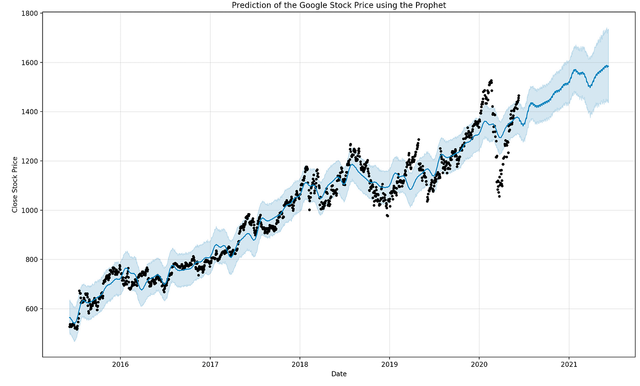
Predictive Models
Aim to make accurate predictions about future or unseen data
Focus on the accuracy of predictions rather than relationships
Emphasis on prediction accuracy.
Often use more complex models

Slide 5
Evaluating Model Performance
Notes:
Guidelines
Use a title slide at the beginning of your presentation. There are 9 variations of title slides to choose from.
If you will have a series of slideshows, we recommend using the same style of title slide for each presentation.
Keep your title to no more than 2 lines.
Do not change the font style or font size of the title or subtitle.

Slide 6
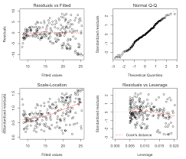
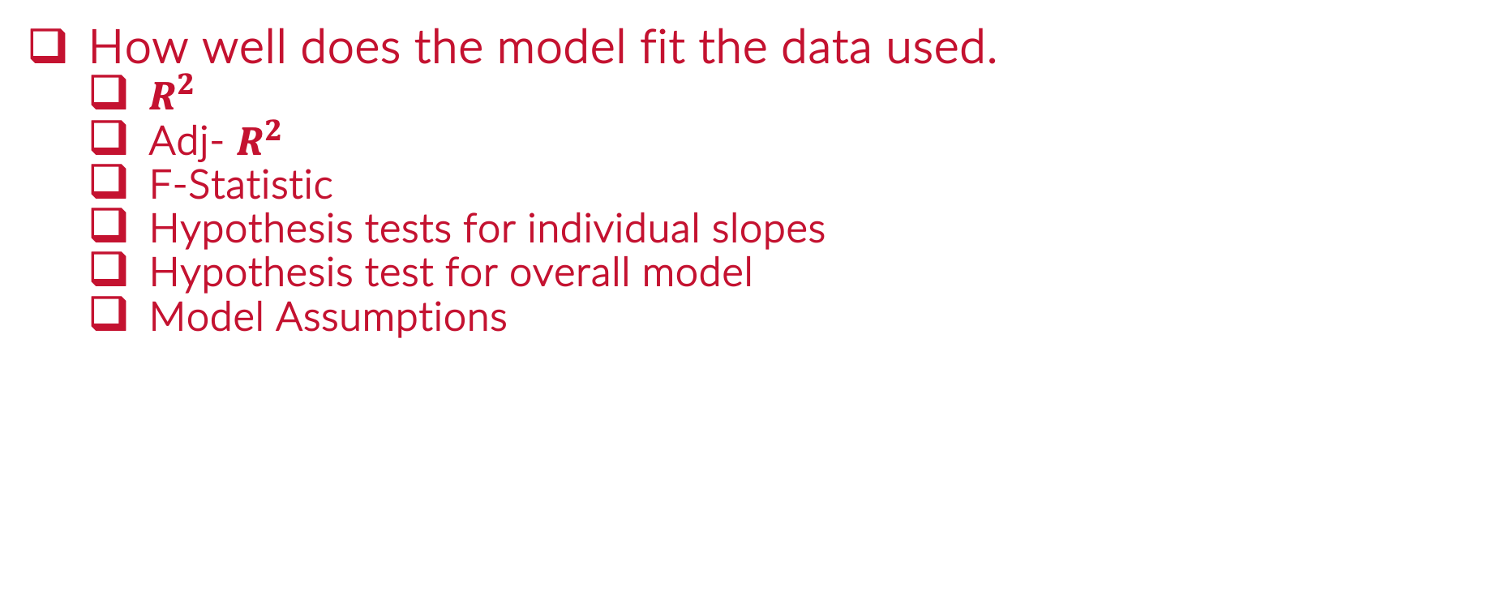
Model Adequacy (Goodness of Fit)
How well does the model fit the data used.
$R^{2}$
Adj- $R^{2}$
F-Statistic
Hypothesis tests for individual slopes
Hypothesis test for overall model
Model Assumptions

Slide 7
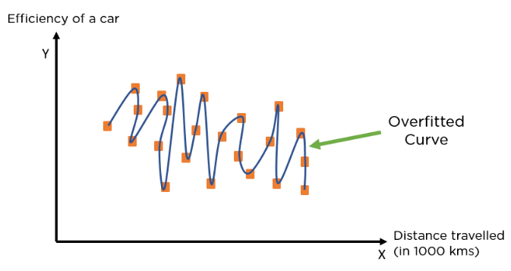
Model Validity (Goodness of Fit)
How well does the model fit in practice (new data)
Goes beyond validity metrics.
We are concerned on overfitting

Slide 8
Overfitting vs Underfitting
Overfitting: occurs when a model is too closely fit to the data
Underfitting: occurs when a model is not sufficient to fit data

Slide 9
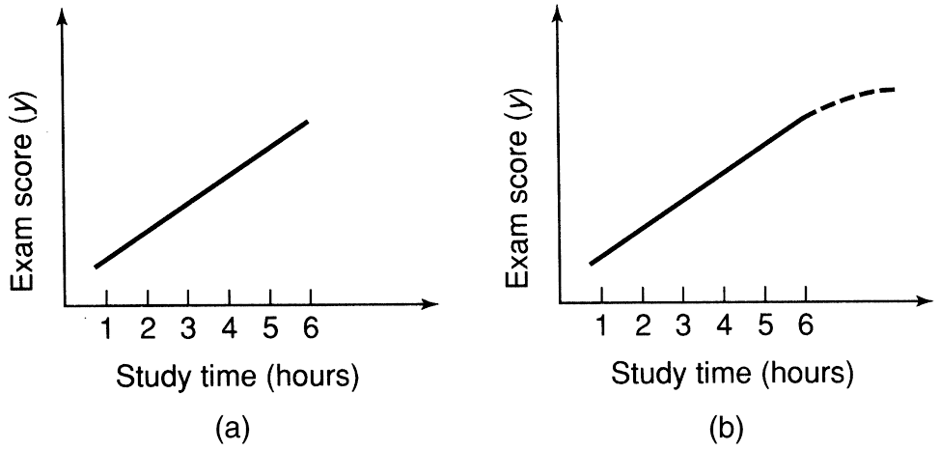
Model Validity (Goodness of Fit)
How well does the model fit in practice (new data)
Goes beyond validity metrics.
We are concerned on extrapolation

Slide 10
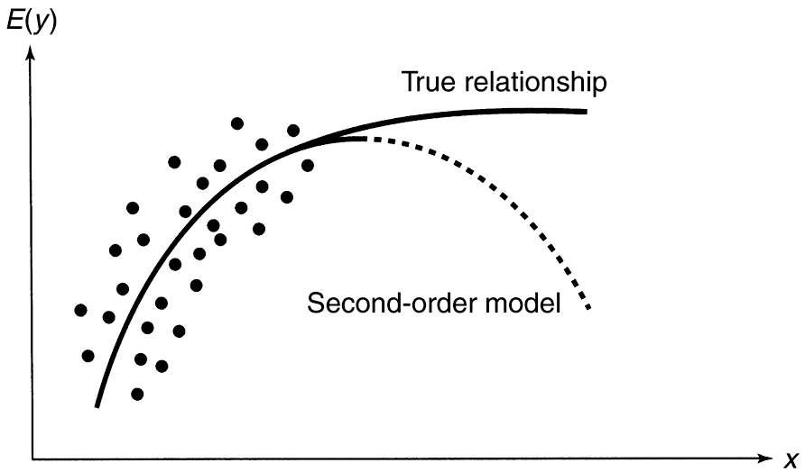
Model Validity (Goodness of Fit)
How well does the model fit in practice (new data)
Goes beyond validity metrics.
We are concerned on robustness of predictions.

Slide 11
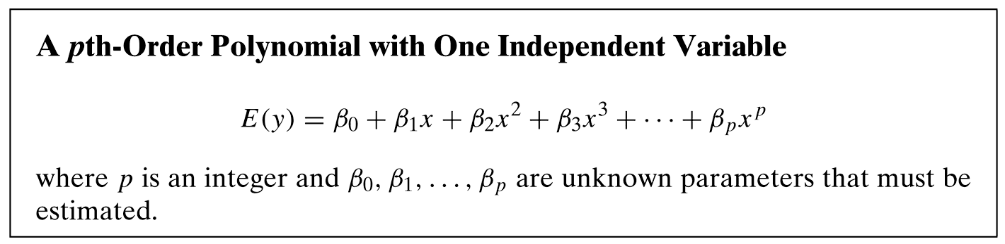
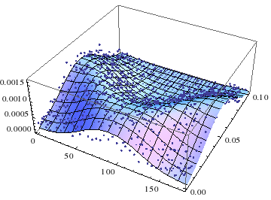
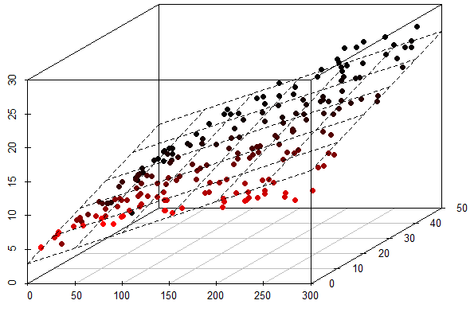
Model Validity

Slide 12
Train/Test Split to Measure Performance
Simulates how your model would perform with new data
Usually more data assigned to training (i.e., 70%, 80%)

Slide 13

k-Fold Cross-Validation
Similar to train/test split
Allows to use ALL data for training

Slide 14
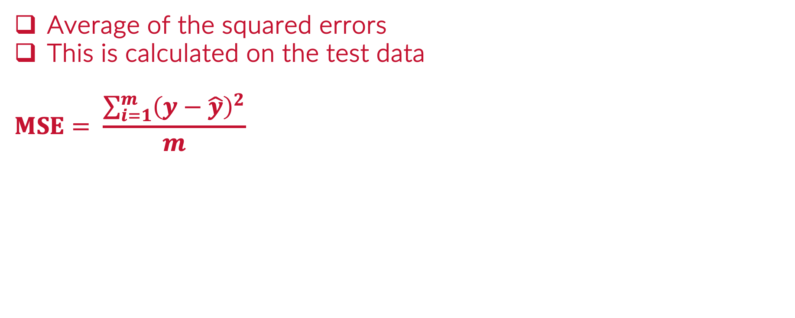
Metrics: Mean Squared Error (MSE)
Average of the squared errors
This is calculated on the test data
$$MSE= \frac{\sum_{i=1}^{m}{{\left(y−\hat{y}\right)}^{2}}}{m}$$
Actual (y) | Predicted (yhat) | Errors | Squared Errors
23.5 | 25.7
45.1 | 43
34.7 | 35.5
29.8 | 30.1
 |  | SSE
 |  | SSE / n

Slide 15



Please download and install the Slido app on all computers you use
A retail company uses a predictive model to forecast monthly sales. The company provides the actual and predicted sales figures for 4 consecutive months (in thousands of dollars). Calculate the MSE for the predictive model.
ⓘ Start presenting to display the poll results on this slide.

Slide 16
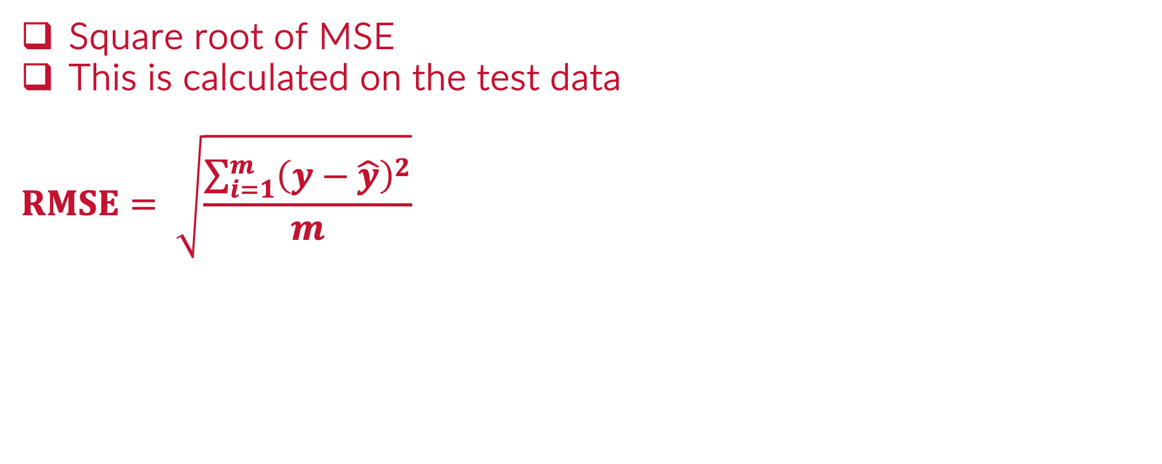
Metrics: Root Mean Squared Error (RMSE)
Square root of MSE
This is calculated on the test data
$$RMSE= \sqrt{\frac{\sum_{i=1}^{m}{{\left(y−\hat{y}\right)}^{2}}}{m}}$$
Actual (y) | Predicted (yhat) | Errors | Squared Errors
23.5 | 25.7
45.1 | 43
34.7 | 35.5
29.8 | 30.1
 |  | SSE
 |  | SSE / n
 |  | sqrt(MSE)

Slide 17
Please download and install the Slido app on all computers you use
A retail company uses a predictive model to forecast monthly sales. The company provides the following actual and predicted sales figures for 4 consecutive months (in thousands of dollars). Using the given data, calculate the Root Mean Squared Error (RMSE) of the predictive model.
ⓘ Start presenting to display the poll results on this slide.

Slide 18
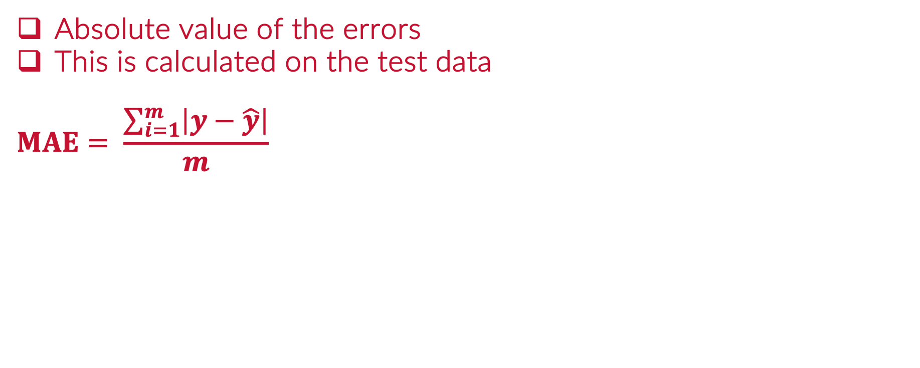
Metrics: Mean Absolute Error (MAE)
Absolute value of the errors
This is calculated on the test data
$$MAE= \frac{\sum_{i=1}^{m}{\left|y−\hat{y}\right|}}{m}$$
Actual (y) | Predicted (yhat) | Errors | Absolute Errors
23.5 | 25.7
45.1 | 43
34.7 | 35.5
29.8 | 30.1
 |  | SAE
 |  | SAE / n

Slide 19
Please download and install the Slido app on all computers you use
A retail company uses a predictive model to forecast monthly sales. The company provides the following actual and predicted sales figures for 4 consecutive months (in thousands of dollars). Using the given data, calculate the Mean Absolute Error (MAE) of the predictive model.
ⓘ Start presenting to display the poll results on this slide.

Slide 20
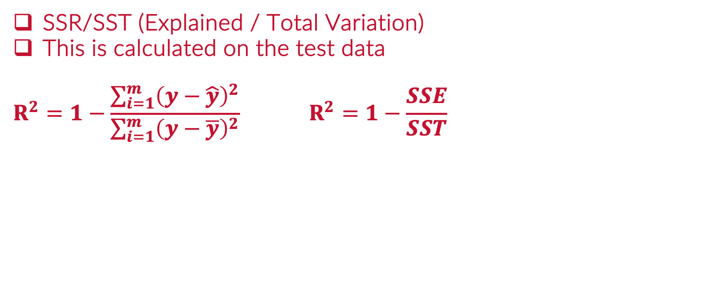
Metrics: R²
SSR/SST (Explained / Total Variation)
This is calculated on the test data
$$R^{2}=1−\frac{\sum_{i=1}^{m}{{\left(y−\hat{y}\right)}^{2}}}{\sum_{i=1}^{m}{{\left(y−\overline{y}\right)}^{2}}} R^{2}=1−\frac{SSE}{SST}$$
Actual (y) | Mean(y) | Errors | Squared Errors
23.5 | 33.275
45.1 | 33.275
34.7 | 33.275
29.8 | 33.275
 |  | SST
Actual (y) | Pred(yhat) | Errors | Squared Errors
23.5 | 25.7
45.1 | 43
34.7 | 35.5
29.8 | 30.1
 |  | SSE

Slide 21
Please download and install the Slido app on all computers you use
A retail company uses a predictive model to forecast monthly sales. The company provides the following actual and predicted sales figures for 4 consecutive months (in thousands of dollars). The mean of the actual sales values is 57.5 thousand. Using the given data, calculate the R-squared (R²) value for the model.
ⓘ Start presenting to display the poll results on this slide.

Slide 22
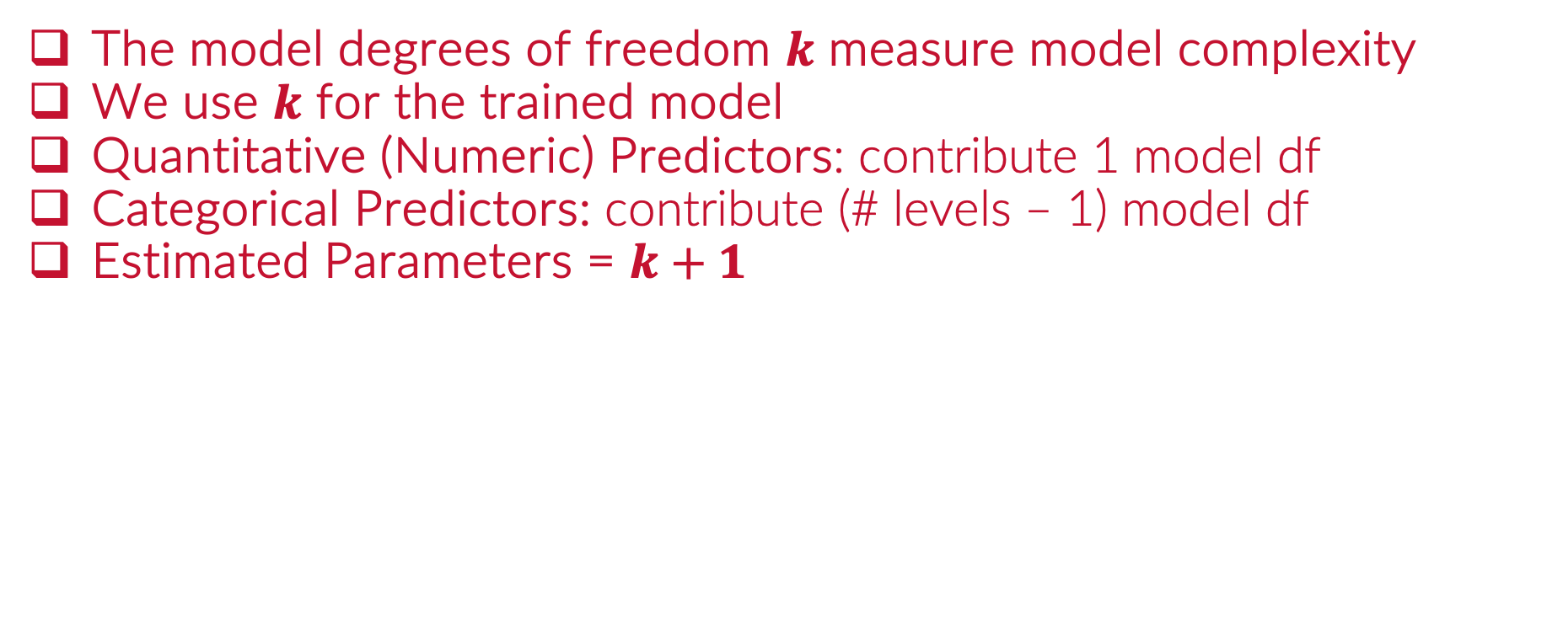
Metrics: Complexity
The model degrees of freedom $k$ measure model complexity
We use $k$ for the trained model
Quantitative (Numeric) Predictors: contribute 1 model df
Categorical Predictors: contribute (# levels – 1) model df
Estimated Parameters = $k+1$

Slide 23
Please download and install the Slido app on all computers you use
A retail company uses a predictive model to forecast monthly sales based on the following actual and predicted sales figures for 4 consecutive months (in thousands of dollars). The model has only 1 predictor. How many parameters are estimated
ⓘ Start presenting to display the poll results on this slide.

Slide 24
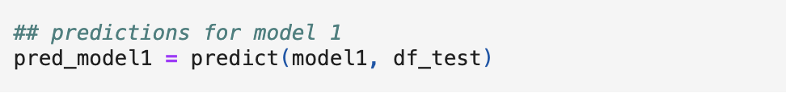
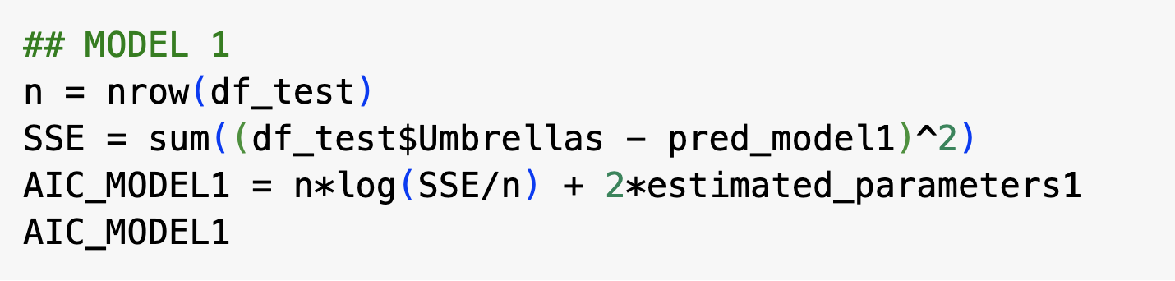
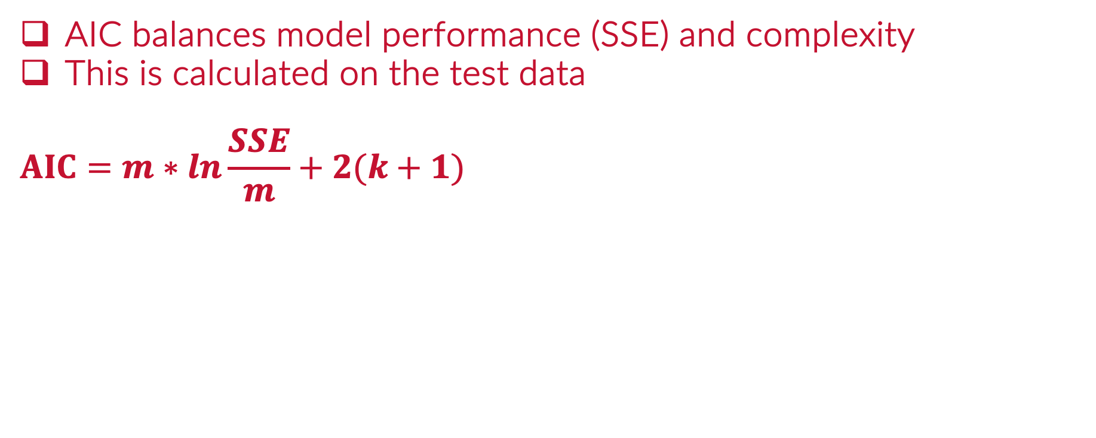
Metrics: Akaike Information Criterion
AIC balances model performance (SSE) and complexity
This is calculated on the test data
$$AIC=m∗ln\frac{SSE}{m}+2(k+1)$$

Slide 25
Please download and install the Slido app on all computers you use
A retail company uses a predictive model to forecast monthly sales based on the following actual and predicted sales figures for 4 consecutive months (in thousands of dollars). The model has only 1 predictor. What is the AIC of the predictive model
ⓘ Start presenting to display the poll results on this slide.

Slide 26
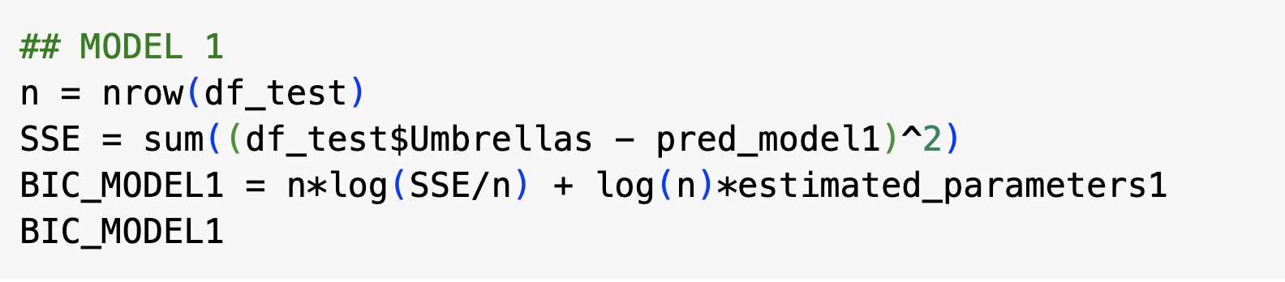
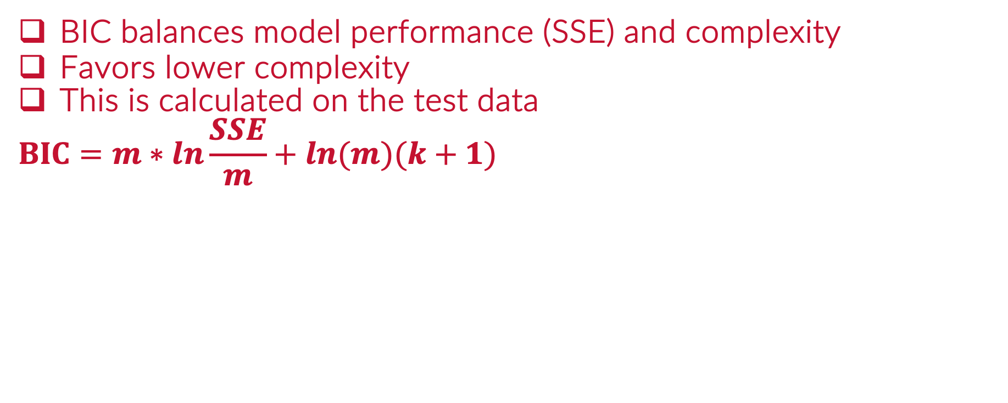
Metrics: Bayesian Information Criterion
BIC balances model performance (SSE) and complexity
Favors lower complexity
This is calculated on the test data
$$BIC=m∗ln\frac{SSE}{m}+ln(m)(k+1)$$

Slide 27
Please download and install the Slido app on all computers you use
A retail company uses a predictive model to forecast monthly sales based on the following actual and predicted sales figures for 4 consecutive months (in thousands of dollars). The model only has 1 predictor. Using this information, calculate the Bayesian Information Criterion (BIC) for the model.
ⓘ Start presenting to display the poll results on this slide.

Slide 28

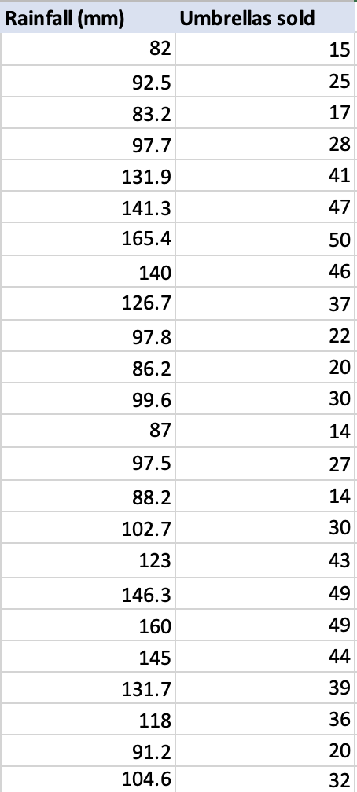
Example: Umbrellas

Slide 29
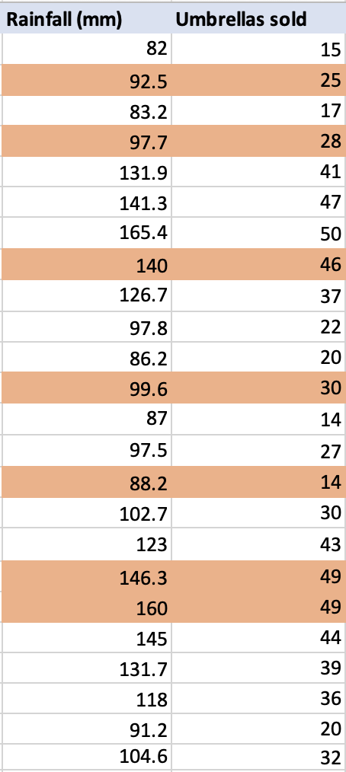
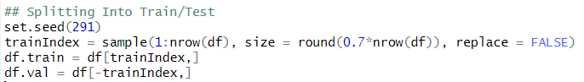
Example: Umbrellas
70%
30%

Slide 30
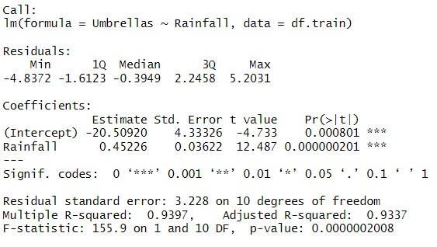
Example: Umbrellas Model 1

Slide 31
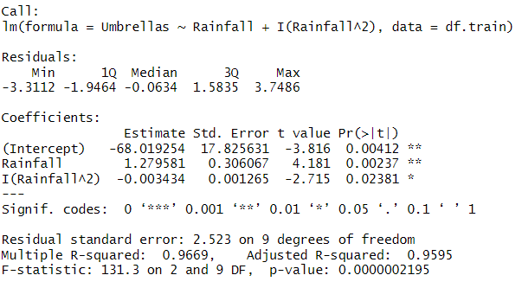
Example: Umbrellas Model 2

Slide 32
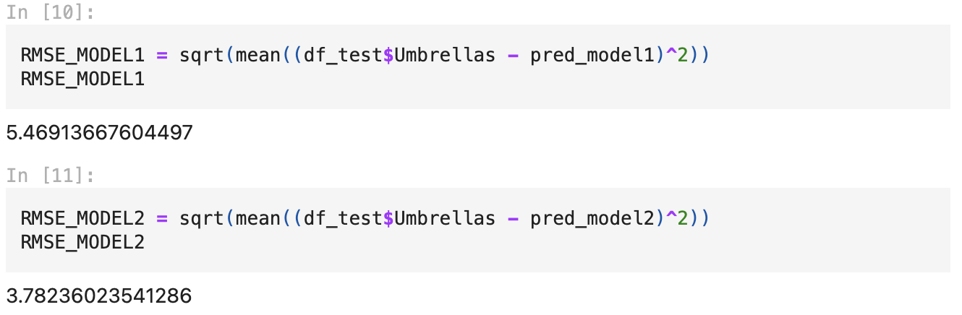
Example: Calculating Metrics on Test
Using multiple metrics can help select best model

Slide 33
Evaluating Model Performance
Notes:
Guidelines
Use a title slide at the beginning of your presentation. There are 9 variations of title slides to choose from.
If you will have a series of slideshows, we recommend using the same style of title slide for each presentation.
Keep your title to no more than 2 lines.
Do not change the font style or font size of the title or subtitle.

Slide 34
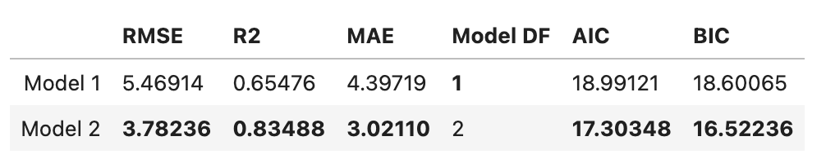
Example: Calculating Metrics on Test
We compare the metrics calculated on the test set
This results in an estimated performance of models on new data

